Slide 1
WI-FI AND WLAN
Anindita Kundu

Slide 2
AGENDA
Introduction
Wi-Fi Technologies
WLAN Standards
WLAN Architecture
Protocol Stack of WLAN
802.11 - Layers and functions
802.11 - Physical layer
802.11 - MAC layer
MAC Management
Handover and Roaming

Slide 3
INTRODUCTION
Wireless Technology is an alternative to Wired Technology, which is commonly used, for connecting devices in wireless mode.
Wi-Fi (Wireless Fidelity) is a generic term that refers to the IEEE 802.11 communications standard for Wireless Local Area Networks (WLANs). Wi-Fi is the standard and WLAN is the application.
Wi-Fi Network connect computers to each other, to the internet and to the wired network.

Slide 4
WI-FI TECHNOLOGIES
Wi-Fi Networks use Radio Technologies to transmit & receive data at high speed:
  IEEE 802.11b
  IEEE 802.11a
  IEEE 802.11g

Slide 5
WIRELESS LAN STANDARDS
802.11b
802.11a
802.11g
Frequency
2.4GHz
5GHz
2.4GHz
Channel
3
8
3
Max. Speed
11Mbps
54Mbps
54Mbps
Real Throughput
4–6 Mbps
22–27 Mbps
22– 27 Mbps
Interference
Yes
No
Yes
Distance for max. speed
120-140 ft.
1-2ft.
120-140 ft.

Slide 6

WLAN ARCHITECTURE
WLAN can work in two different modes:
Infrastructure mode
  The access point present, controls the medium access.
  The access point bridges the network to other wired or wireless network.
Ad Hoc Mode
  Each node communicate directly with other nodes if they are within radio range of each other.
  No access points required.
  Node complexity is high as the medium access, hidden and exposed terminal problems are handled by nodes itself.
AP: Access Point
AP
AP
wired network
AP

Slide 7
802.11 - ARCHITECTURE OF AN INFRASTRUCTURE NETWORK
802.11 LAN
Station (STA)
  terminal with access mechanisms to the wireless medium and radio contact to the access point
Basic Service Set (BSS)
  group of stations using the same radio frequency
Access Point
  station integrated into the wireless LAN and the distribution system
Portal
  bridge to other (wired) networks
Distribution System
  interconnection network to form one logical network (ESS: Extended Service Set) based on several BSS
802.x LAN
STA₁
BSS₁
Access
Point
Portal
Distribution System
ESS
Access
Point
BSS₂
STA₂
802.11 LAN
STA₃

Slide 8
802.11 - ARCHITECTURE OF AN AD-HOC NETWORK
802.11 LAN
Direct communication within a limited range
  Station (STA):
  terminal with access mechanisms to the wireless medium
  Basic Service Set (BSS):
  group of stations using the same radio frequency
STA₁
STA₃
BSS₁
STA₂
BSS₂
STA₅
STA₄
802.11 LAN

Slide 9
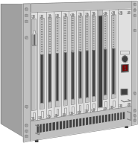


PROTOCOL STACK OF WLAN
fixed terminal
mobile terminal
server
infrastructure network
access point
Application
TCP
IP
LLC
802.11 MAC
802.11 PHY
Application
TCP
IP
LLC
LLC
802.11 MAC
802.3 MAC
802.3 MAC
802.11 PHY
802.3 PHY
802.3 PHY

Slide 10
802.11 - LAYERS AND FUNCTIONS
PLCP (Physical Layer Convergence Protocol)
  clear channel assessment (CCA) signal (carrier sense)
  provide common PHY service access point independent of transmission technology
PMD (Physical Medium Dependent)
  modulation, encoding, decoding
PHY Management
  channel selection, MIB
Station Management
  coordination of all management functions
MAC
  Medium access, fragmentation, encryption
MAC Management
  Synchronization, authentication, roaming, Management Information Base (MIB), power management.
Station Management
LLC
DLC
MAC Management
MAC
PLCP
PHY Management
PHY
PMD

Slide 11
802.11 - PHYSICAL LAYER
The Physical layer has three versions
  FHSS (Frequency Hopping Spread Spectrum)
  DSSS (Direct Sequence Spread Spectrum)
  Infrared
FHSS and DSSS uses the radio channels each of bandwidth 1 MHz in the 2.4GHz ISM band

Slide 12
FHSS
  Frequency-hopping spread spectrum (FHSS) is a method of transmitting radio signals by rapidly switching a carrier among many frequency channels, using a pseudo-random sequence known to both transmitter and receiver.
DSSS
  Direct-sequence spread-spectrum transmissions multiply the data being transmitted by a "noise" signal.
  This noise signal is a pseudorandom sequence of 1 and −1 values, at a frequency much higher than that of the original signal.
  The resulting signal resembles white noise, like an audio recording of "static".
  However, this noise-like signal can be used to exactly reconstruct the original data at the receiving end, by multiplying it by the same pseudorandom sequence (because 1 × 1 = 1, and −1 × −1 = 1).
  This process, known as "de-spreading", mathematically constitutes a correlation of the transmitted PN sequence with the PN sequence that the receiver believes the transmitter is using.

Slide 13
802.11 - PHYSICAL LAYER
Spread Spectrum | Infrared
Frequency Hopping (FHSS) | Direct Sequence (DSSS) | Diffused Infrared | Directed Beam Infrared
1 – 3 | 2 – 20 | 1 – 4 | 1 – 10
Mobile | Sationary or Mobile | Sationary or Mobile | Stationary with LOS
30 – 100 | 30 – 250 | 15 – 60 | 25
Data Rate (Mbps)
Mobility
Range (m)
Detectability | Little | Negligible
Wavelength or Frequency | 902 – 928 MHz 2.4 – 2.4835 GHz 5.725 – 5.85 GHz | 800 – 900 nm
Modulation Technique | GFSK | ASK
Radiated Power | < 1W | -
Access Method | CSMA | CSMA
License Requirement | No | No
DBPSK/DQPSK
Token Ring

Slide 14
FHSS PHY PACKET FORMAT
Synchronization
  Synchronization of potential receivers and signal detection by the CCA with 010101... pattern
SFD (Start Frame Delimiter)
  0000110010111101 start pattern
  Provide frame synchronization
PLW (PLCP_PDU Length Word)
  First field of the PLCP header
  length of payload incl. 32 bit CRC of payload, 0<PLW < 4096
PSF (PLCP Signaling Field)
  Data rate of payload (1 or 2 Mbit/s). 0000 implies1Mbps, 0010 implies 2Mbps and 1111 implies the max. of 8.5Mbps.
HEC (Header Error Check)
  16 bit checksum with generator polynomial G(x) = x +x + x +1
16
12
5
80
16
12
4
16
variable
bits
synchronization
SFD
PLW
PSF
HEC
Payload
PLCP preamble
PLCP header

Slide 15
DSSS PHY PACKET FORMAT
Synchronization
  synch., gain setting, energy detection (for CCA), frequency offset compensation
SFD (Start Frame Delimiter)
  1111001110100000
Signal
  data rate of the payload (0x0A: 1 Mbit/s DBPSK; 0x14: 2 Mbit/s DQPSK)
Service
  future use, 0x00 => 802.11 compliant
Length
  Length of the payload (in micro seconds)
HEC (Header Error Check)
  Checksum used for protection of signal, service and length, x +x +x +1
16
12
5
128
16
8
8
16
16
variable
bits
synchronization
SFD
signal
service
length
HEC
Payload
PLCP preamble
PLCP header

Slide 16
802.11 - MAC LAYER-MAC LOGIC
Wait for frame
to transmit
No
Medium idle
?
Yes
Wait until current Tx ends
Wait DIFS
Wait DIFS
No
Still idle ?
No
Still idle ?
Yes
Yes
Exponential Back off when medium idle
Transmit Frame

Slide 17
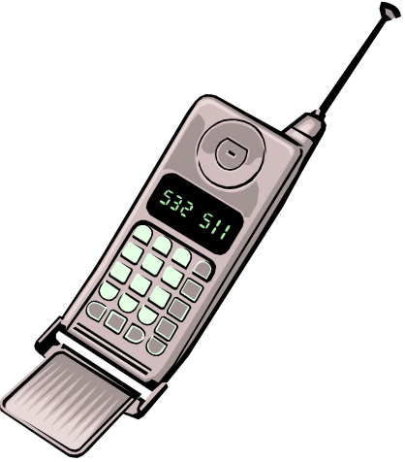
“Hidden” and “Exposed” Terminals
A
B
C
D
A and C can start sending simultaneously to B; carrier sense fails.
→ A is hidden for C and vice versa.
When B sends something to A, C cannot send to D outside the
interference range of A and B → unnecessary delay. C is exposed to B.

Slide 18
802.11 - MAC layer- Distributed Foundation Wireless MAC
Traffic services
  Asynchronous Data Service (mandatory)
    exchange of data packets based on “best-effort”
    support of broadcast and multicast
  Time-Bounded Service (optional)
    implemented using PCF (Point Coordination Function)
    Supported in infrastructure mode only
Access methods
  Basic DFWMAC-DCF CSMA/CA (mandatory)
    collision avoidance using random back-off mechanism
    minimum distance between consecutive packets
    ACK packet for acknowledgements (not for broadcasts)
  DFWMAC-DCF with RTS/CTS (optional)
    avoids hidden terminal problem
  DFWMAC- PCF (optional)
    access point polls terminals according to a list

Slide 19
802.11 - MAC LAYER
Priorities
  defined through different inter frame spaces
  no guaranteed, hard priorities
  SIFS (Short Inter Frame Spacing)
    highest priority, for ACK, CTS, polling response
  PIFS (PCF IFS)
    medium priority, for time-bounded service using PCF
  DIFS (DCF, Distributed Coordination Function IFS)
    lowest priority, for asynchronous data service
DIFS
DIFS
PIFS
medium busy
SIFS
contention
next frame
t
direct access if
medium is free ≥ DIFS

Slide 20
802.11 - CSMA/CA ACCESS METHOD
contention window
(randomized back-off
mechanism)
DIFS
DIFS
medium busy
next frame
direct access if
medium is free ≥ DIFS
t
slot time
  Sending broadcast frames:
  station ready to send starts sensing the medium (Carrier Sense based on CCA, Clear Channel Assessment)
  if the medium is free for the duration of an Inter-Frame Space (IFS), the station can start sending (IFS depends on service type)
  if the medium is busy, the station has to wait for a free IFS, then the station must additionally wait a random back-off time (collision avoidance, multiple of slot-time)
  if another station occupies the medium during the back-off time of the station, the back-off timer stops (fairness)

Slide 21
802.11 - competing stations - simple version
DIFS
DIFS
DIFS
DIFS
bo_{e}
bo_{r}
bo_{e}
bo_{r}
bo_{e}
busy
station₁
bo_{e}
busy
station₂
busy
station₃
bo_{e}
busy
bo_{e}
bo_{r}
station₄
bo_{e}
bo_{r}
bo_{e}
busy
bo_{e}
bo_{r}
station₅
t
busy
medium not idle (frame, ack etc.)
bo_{e}
elapsed backoff time
packet arrival at MAC
bo_{r}
residual backoff time
Back off time = elapsed backoff time + residual backoff time

Slide 22
802.11 - CSMA/CA access method II
Sending unicast packets
  station has to wait for DIFS before sending data
  receivers acknowledge at once (after waiting for SIFS) if the packet was received correctly (CRC)
  automatic retransmission of data packets in case of transmission errors
DIFS
data
sender
SIFS
ACK
receiver
DIFS
other
stations
data
t
waiting time
contention
7.16.1

Slide 23
802.11 – DFWMAC-RTS/CTS
Sending unicast packets
  station can send RTS with reservation parameter after waiting for DIFS (reservation determines amount of time the data packet needs the medium)
  acknowledgement via CTS after SIFS by receiver (if ready to receive)
  sender can now send data at once, acknowledgement via ACK
  other stations store medium reservations distributed via RTS and CTS
DIFS
RTS
data
sender
SIFS
SIFS
SIFS
CTS
ACK
receiver
NAV (RTS)
DIFS
other
stations
data
NAV (CTS)
t
defer access
contention
7.17.1

Slide 24
Fragmentation of user data
DIFS
RTS
frag₁
frag₂
sender
SIFS
SIFS
SIFS
SIFS
SIFS
CTS
ACK₁
ACK₂
receiver
NAV (RTS)
NAV (CTS)
NAV (frag₁)
DIFS
data
other
stations
NAV (ACK₁)
t
contention
7.18.1

Slide 25
DFWMAC-PCF I
t₀
t₁
SuperFrame
medium busy
PIFS
SIFS
SIFS
point
coordinator
D₁
D₂
SIFS
SIFS
U₁
U₂
wireless
stations
stations‘
NAV
NAV
7.19.1

Slide 26
DFWMAC-PCF II
t₂
t₃
t₄
PIFS
SIFS
D₃
D₄
CF_{end}
point
coordinator
SIFS
U₄
wireless
stations
stations‘
NAV
NAV
contention free period
contention
period
t
7.20.1

Slide 27
802.11 - Frame format
Types
  control frames, management frames, data frames
Sequence numbers
  important against duplicated frames due to lost ACKs
Addresses
  receiver, transmitter (physical), BSS identifier, sender (logical)
Miscellaneous
  sending time, checksum, frame control, data
bytes
2
2
6
6
6
2
6
0-2312
4
Frame
Control
Duration
ID
Address
1
Address
2
Address
3
Sequence
Control
Address
4
Data
CRC
Bits
2
2
4
1
1
1
1
1
1
1
1
Protocol version
Type
Sub type
To DS
From DS
More Flag
Retry
Power Mgmnt
More Data
WEP
Order

Slide 28
The IEEE 802.11 addressing mechanism specifies four cases, defined by the value of the two flags in the FC field,
  To DS and
  From DS.
Each flag can be either 0 or 1, resulting in four different situations.
The interpretation of the four addresses (address 1 to address 4) in the MAC frame depends on the value of these flags

Slide 29
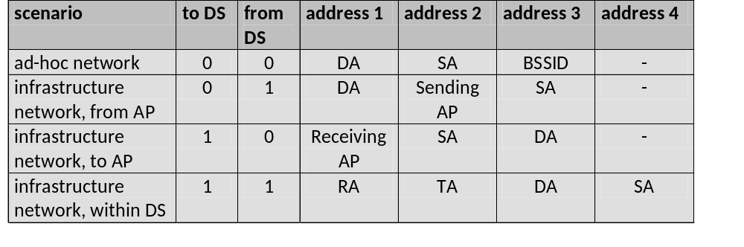
MAC address format
AP: Access Point
DA: Destination Address
SA: Source Address
BSSID: Basic Service Set Identifier
RA: Receiver Address
TA: Transmitter Address

Slide 30
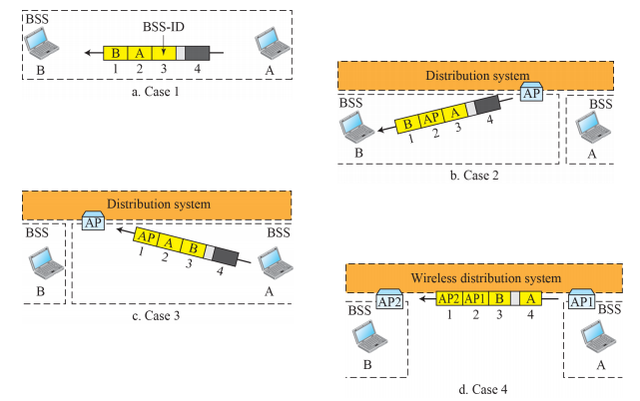

Slide 31
FRAME STRUCTURE OF SPECIAL CONTROL PACKETS
bytes
2
2
6
4
ACK
Frame Control
Duration
Receiver’s Address
CRC
bytes
2
2
6
4
RTS
Frame Control
Duration
Receiver’s Address
CRC
bytes
2
2
6
4
CTS
Frame Control
Duration
Receiver’s Address
Transmitter’s Address
CRC

Slide 32
802.11 - MAC management
Synchronization
  try to find a LAN, try to stay within a LAN
  timer etc.
Power management
  sleep-mode without missing a message
  periodic sleep, frame buffering, traffic measurements
Association/Reassociation
  integration into a LAN
  roaming, i.e. change networks by changing access points
  scanning, i.e. active search for a network
MIB - Management Information Base
  managing, read, write

Slide 33
Synchronization using a Beacon (infrastructure)
beacon interval
B
B
B
B
access
point
busy
busy
busy
busy
medium
t
value of the timestamp
B
beacon frame
7.24.1

Slide 34
Synchronization using a Beacon (ad-hoc)
beacon interval
B₁
B₁
station₁
B₂
B₂
station₂
busy
busy
busy
busy
medium
t
value of the timestamp
B
beacon frame
random delay
7.25.1

Slide 35
Power management
Idea: switch the transceiver off if not needed
States of a station: sleep and awake
Timing Synchronization Function (TSF)
  stations wake up at the same time
Infrastructure
  Traffic Indication Map (TIM)
    list of unicast receivers transmitted by AP
  Delivery Traffic Indication Map (DTIM)
    list of broadcast/multicast receivers transmitted by AP
Ad-hoc
  Ad-hoc Traffic Indication Map (ATIM)
    announcement of receivers by stations buffering frames
    more complicated - no central AP
    collision of ATIMs possible (scalability?)

Slide 36
Power saving with wake-up patterns (infrastructure)
TIM interval
DTIM interval
D
B
T
T
d
D
B
access
point
busy
busy
busy
busy
medium
p
d
station
t
T
TIM
D
DTIM
awake
B
p
d
data transmission
To / from the station
broadcast/multicast
PS poll

Slide 37
POWER SAVING WITH WAKE-UP PATTERNS (AD-HOC)
ATIM Window
Beacon interval
Station 1
Station 2
Beacon frame
Random delay
awake
Transmit ATIM
Acknowledgement data
Acknowledgement frame
Transmit data

Slide 38
HANDOVER
AP1
AP2
1. Station decides that current link quality to its access point AP1 is too poor.
2. Station starts scanning for another AP.
3. Station chooses nearest access point based on signal strength
4. Station sends association request to the new AP, AP2
5. The AP2 sends association response.
6. The AP introduces the station to its DS
7. The DS updates its database.
8. DS informs the old AP that the station is no longer within its BSS

Slide 39
802.11 - Roaming
No or bad connection? Then perform:
Scanning
  scan the environment, i.e., listen into the medium for beacon signals or send probes into the medium and wait for an answer
Reassociation Request
  station sends a request to one or several AP (s)
Reassociation Response
  success: AP has answered, station can now participate
  failure: continue scanning
AP accepts Reassociation Request
  signal the new station to the distribution system
  the distribution system updates its data base (i.e., location information)
  typically, the distribution system now informs the old AP so it can release resources

Slide 40
ADVANTAGES
Mobility
Ease of Installation
Flexibility
Cost
Reliability
Security
Use unlicensed part of the radio spectrum
Roaming
Speed

Slide 41
LIMITATIONS
Interference
Degradation in performance
High power consumption
Limited range
Hidden terminal problem
Exposed terminal problem

Slide 42
Future developments
IEEE 802.11a
  compatible MAC, but now 5 GHz band
  transmission rates up to 20 Mbit/s
  close cooperation with BRAN (ETSI Broadband Radio Access Network)
IEEE 802.11b
  higher data rates at 2.4 GHz
  proprietary solutions already offer 10 Mbit/s
IEEE WPAN (Wireless Personal Area Networks)
  market potential
  compatibility
  low cost/power, small form factor
  technical/economic feasibility
  ➔ Bluetooth

Slide 43
REFERENCES:-
William Stallings, Wireless Communication and Networks.
Schiller, Mobile Communications.

Slide 44
Q n A!!!

